Slide 1
AGRONOMY ADVANCEMENTS
By: Prashant Vikram Singh
Sudhanshu Garg
Vipul Krishna

Slide 2
PROBLEM STATEMENT
United Nations Organizations has conducted a survey which reveals that over the next 40 years, the world’s population would swell up to nine billion. In order to cope with this massive rise in the number, the food production should ramp up by 70% of what it is now. With our idea, we would try and help farmers to increase their crop productivity which going down the line might come in very handy in making the crop production commensurate to the population explosion.
Also, many farmers do not have access to information about advanced farming techniques and still rely on the old and conventional methods. They sometimes run into heavy debts because of crop failure.
With this application, an intensive solution will be provided to the farmers pertaining to their crops which will help their produce get better qualitatively and quantitatively. Farmers also have facility to get connected with network vendor and get the right worth of their produce.

Slide 3
APPROACH OF ACCOMPLISHMENT
Ecosystem Model
We have used the ecosystem model approach to design our application.
This model provides us with a way of developing applications which are easily scalable.
Modifications become simpler by implementing this model.

Slide 4
Major Use Cases
We will provide farmers with all details of advanced techniques and technologies on farming.
Farmers can have their soil samples tested in our research laboratories.
Improvements pertaining to the existing farming method and cultivation type will be suggested to the farmers.
Farmers can implement the suggested methods which will grow make their produce better.
Farmers get to see the guidelines on how to use our application
Farmers get general about all major crops on their home page information on their home page.
Farmer can reach out to the research team about all the queries they have during the cultivation of the crop.
Farmers can write feedback about the application which is sent directly to the enterprise admin organization.

Slide 5
Major Use Cases
Once the crop is ready, farmers can post the sale request to different markets.
Farmers come in contact with the Vendors directly and sell their produce.
Interested Vendors respond to the Sale request with their quotation.
This eliminates the intermediate brokerage costs and farmers get the right value and worth of the crops.
In this way farmers can have a better income and have a decent standard of living.
There is intensive report generation system also employed in our application.
Only enterprise admin has the access to view reports.
Enterprise admin can assess farmer’s feedback and implement improvements in the application

Slide 6
Major Use Cases
Admin also has access to reports on the individual organization’s performance.
Admin can view reports on requests pending with each department.
Apart from these use cases, the ecosystem model is implemented with all login features.
Farmers have a sign up page where they can create an account in a few easy steps.

Slide 7
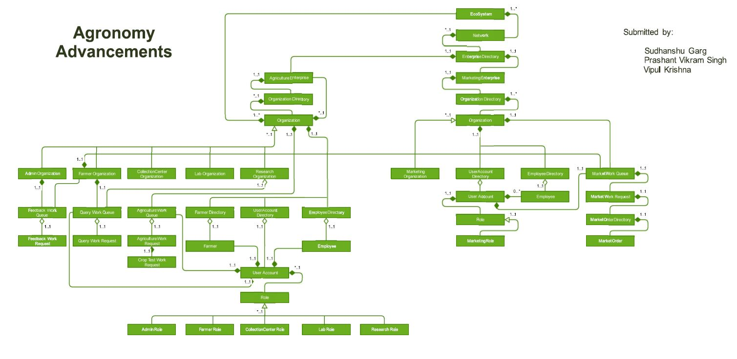
OBJECT MODEL

Slide 8
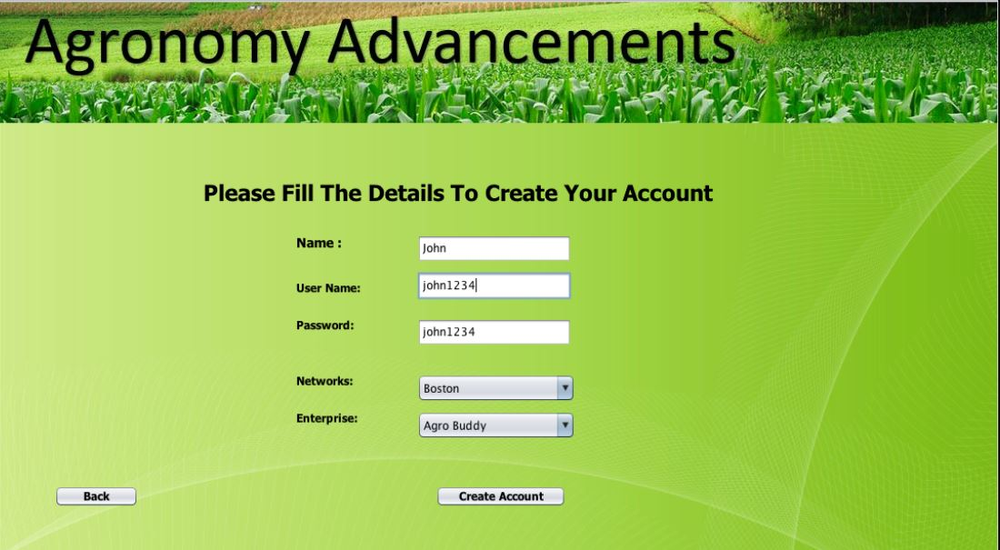
Farmer Sign Up

Slide 9
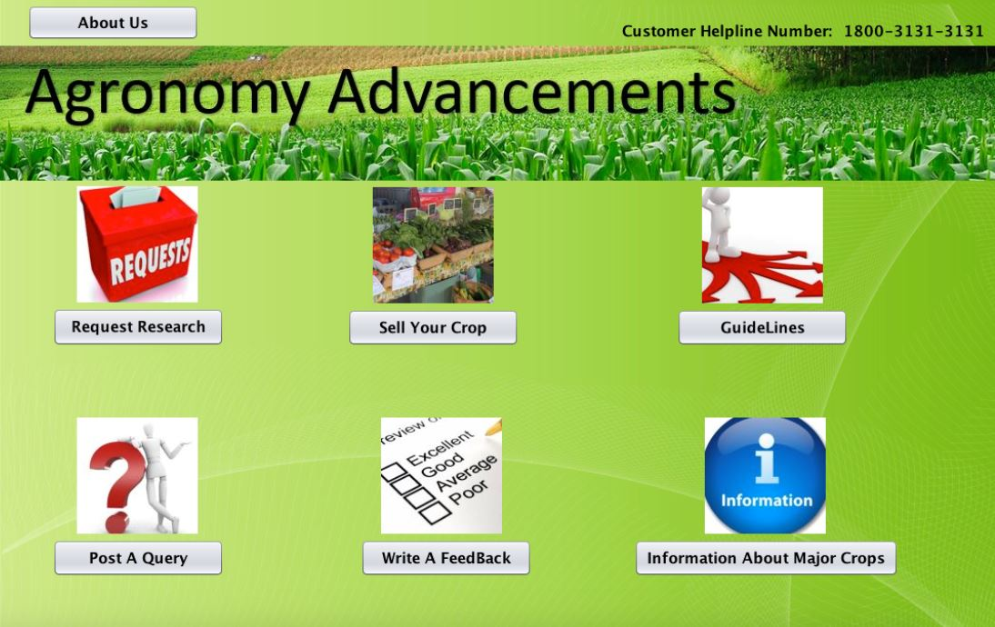
Farmer Home Page

Slide 10
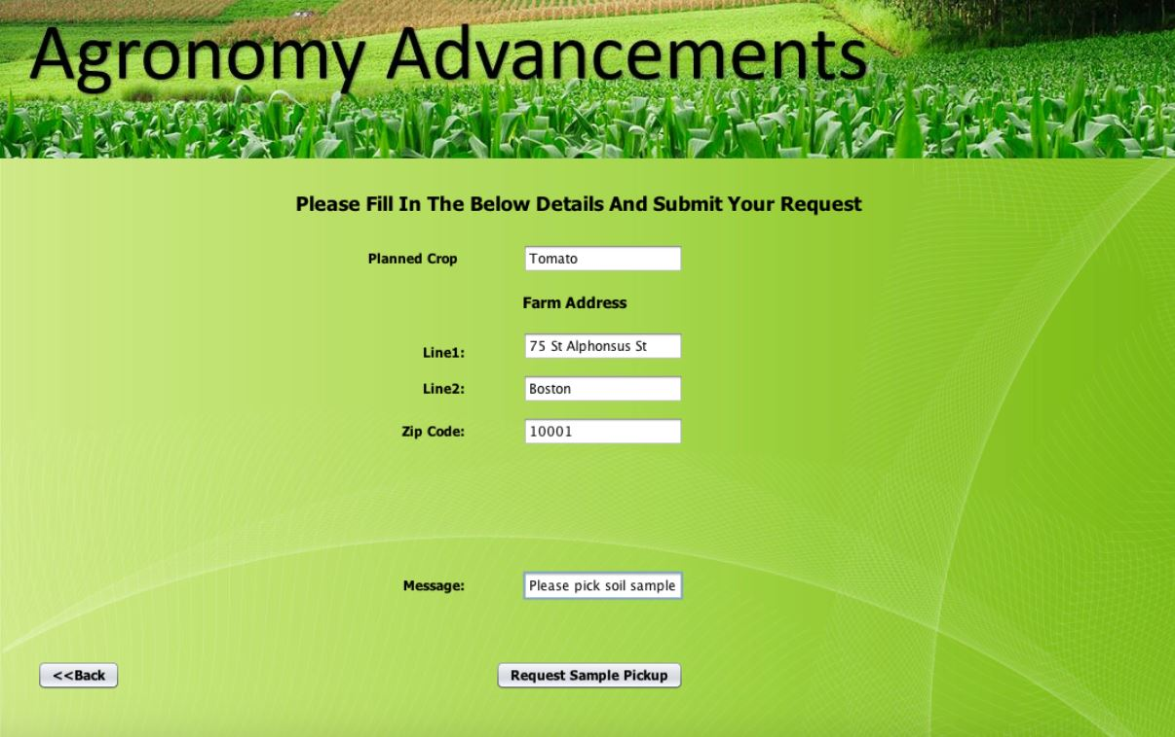
Farmer Request Page

Slide 11
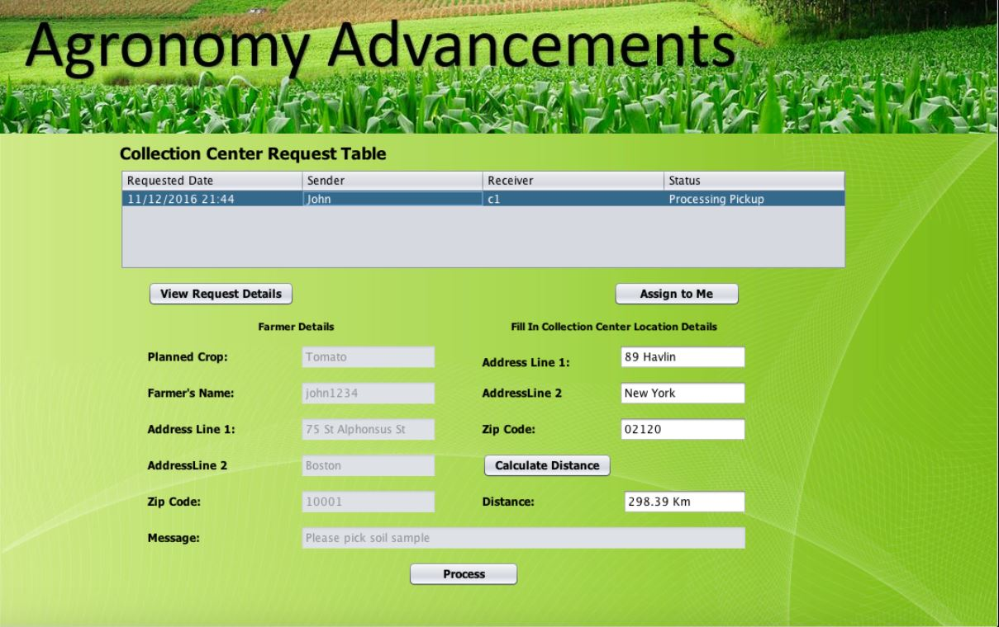
Collection Center Page

Slide 12
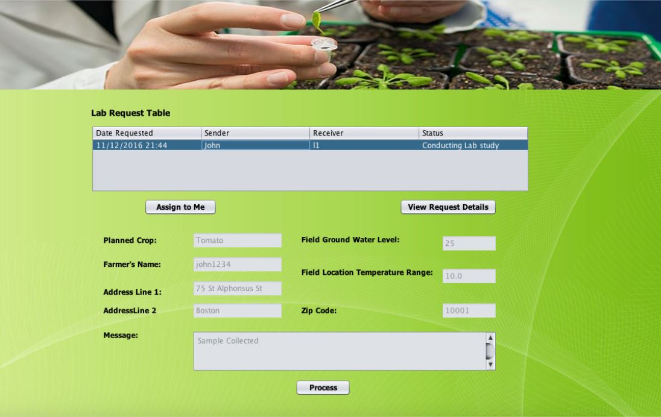
Lab Test Page

Slide 13
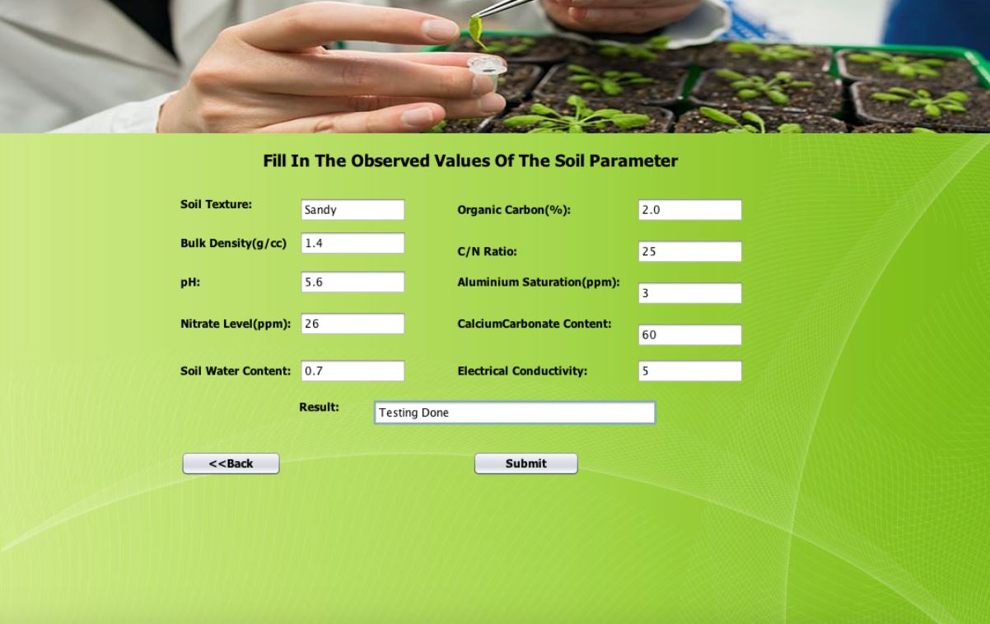
Lab Test Result Page

Slide 14
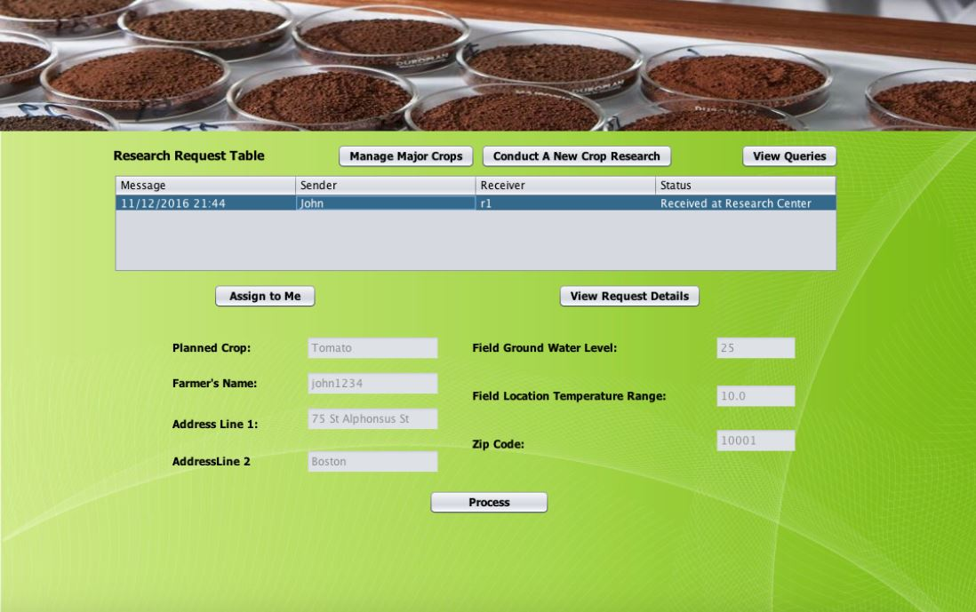
Research Center Home Page

Slide 15
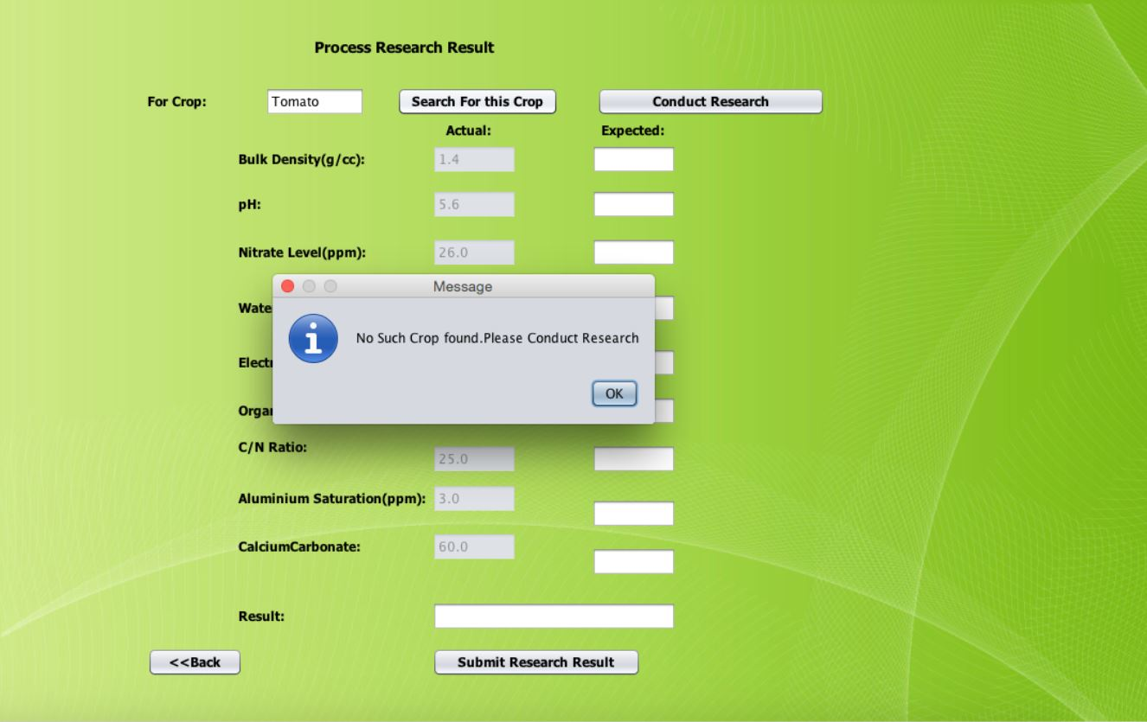
Research Test Result Page

Slide 16
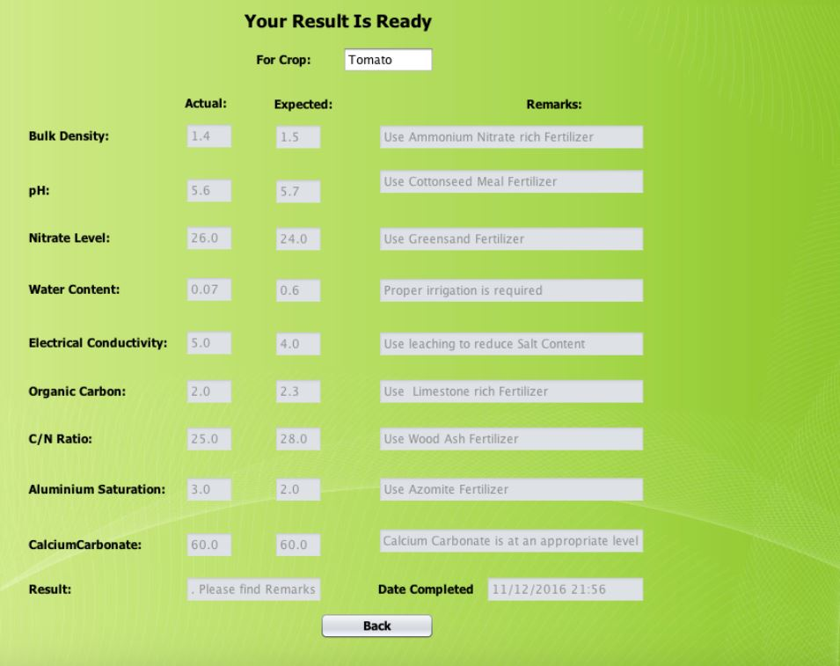
Farmer View Result

Slide 17
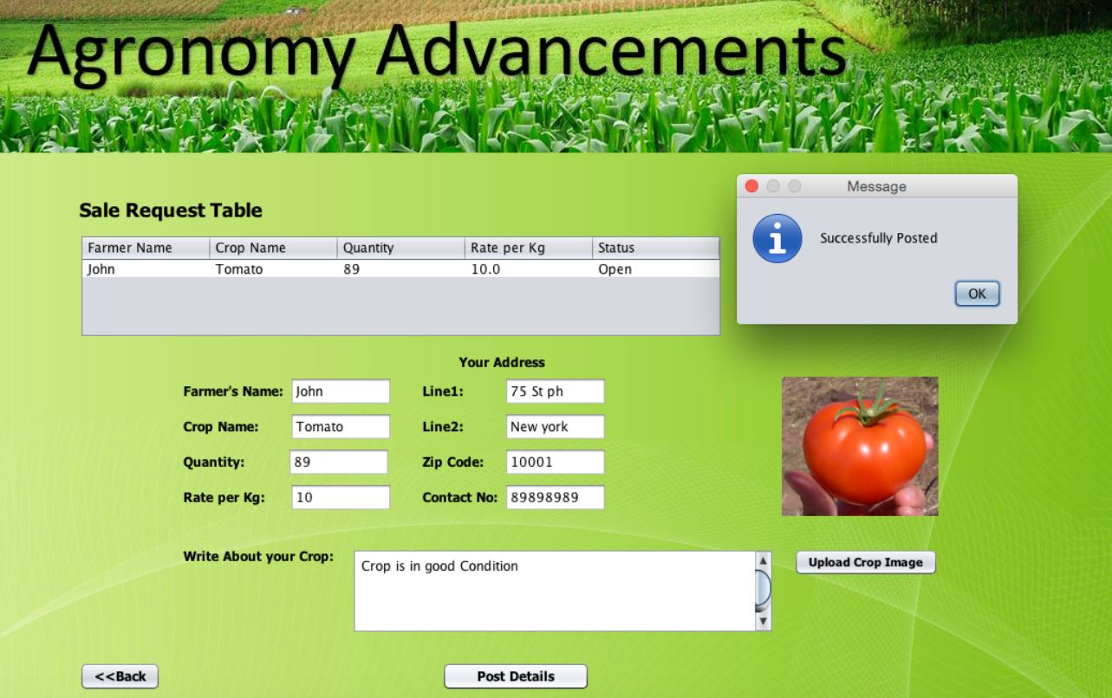
Farmer Sell Crop

Slide 18
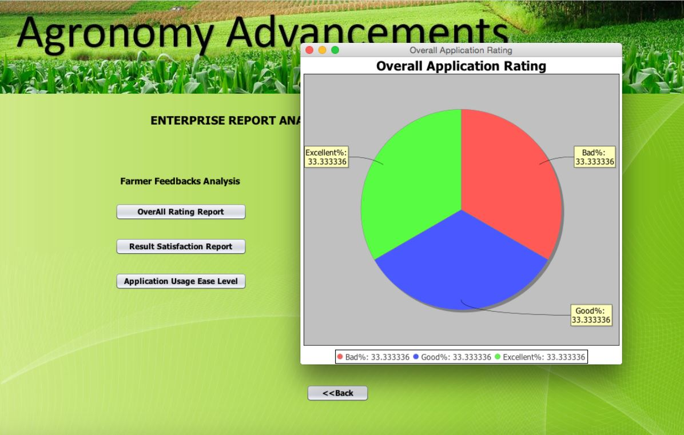
Report

Slide 19
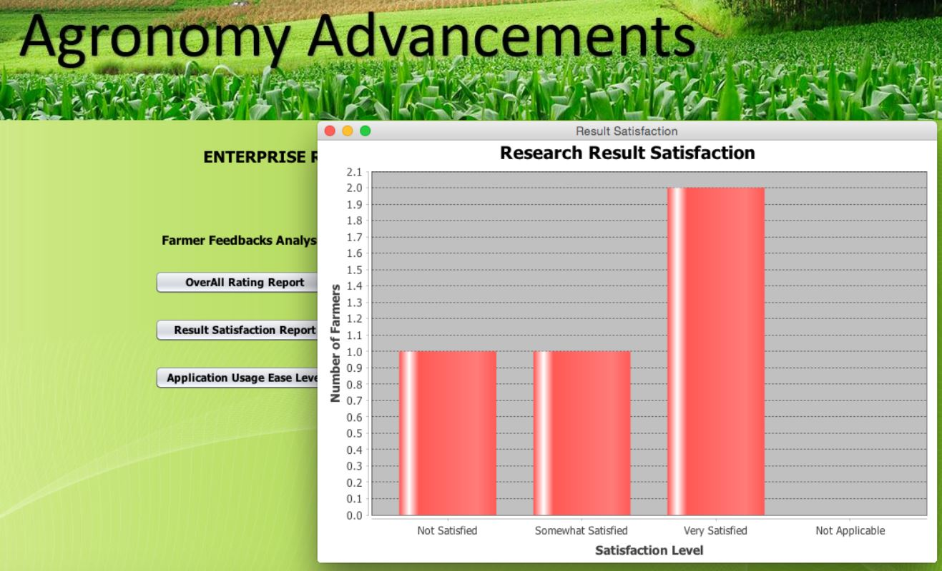
Report

Slide 20
CONCLUSION
This idea will serve the genesis of our ecosystem, i.e., farmers and food production. The food shortage issue forecasted by the United Nations Organizations can be curtailed to a great extent. This model will render great qualitative and quantitative benefits to the farmers. The crop spoilage would decrease as farmers get in touch with the market vendors real soon through our application. This model would enhance the farmer’s standard of living with better food production in the same available land along with better food quality. The farmers form an integral part of the society and if they prosper, the entire society will prosper along with them.

Slide 21
REFERENCES
MIT Media Lab Open Agriculture
http://openag.media.mit.edu/
ENAM – A Government of India Website for Farmers
http://www.enam.gov.in/
Penn State Extension – Soil Quality Study
http://extension.psu.edu/business/start-farming/soils-and-soil-management/soil-quality
Weekend Gardener – Monthly Web Magazine.
http://www.cropnutrition.com/efu-soil-ph[10:00] http://www.weekendgardener.net/garden-plants/best-garden-fertilizers-060906.htm
Wikipedia

